Slide 1



How do resource abundance and predictability affect animal movement?
Stefano Mezzini – M.Sc. Biol.

Slide 2
Hypotheses
Resource abundance lowers spatial needs
Stochasticity (randomness) increases spatial needs
Stochasticity lowers resource abundance (interaction effect)
Low space lowers fitness, increases conflicts

Slide 3
Fuzzy gralbers and space use

Slide 4
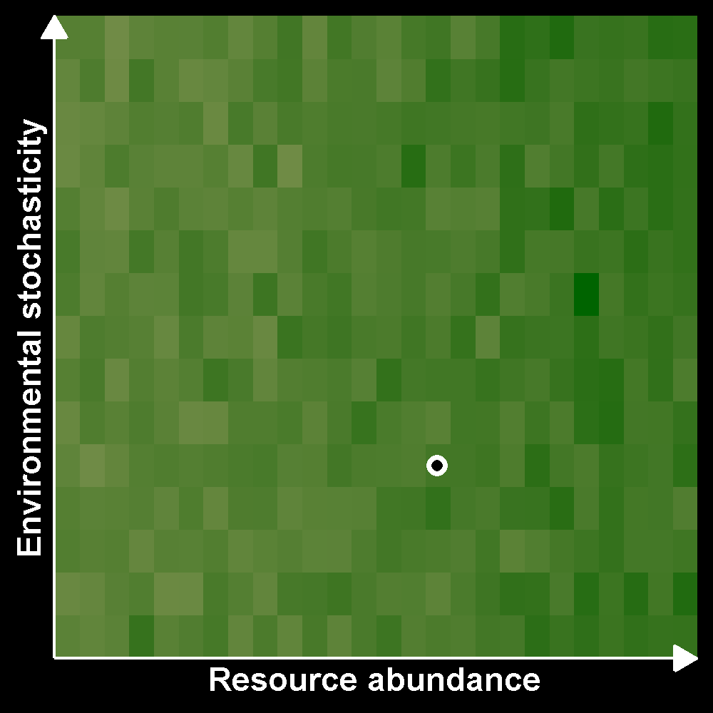
Fuzzy gralbers (Gralbus wagneri)
Very elusive, but born with GPS
Live in abstract space
Eat green pixels
Cannot sleep

Slide 5
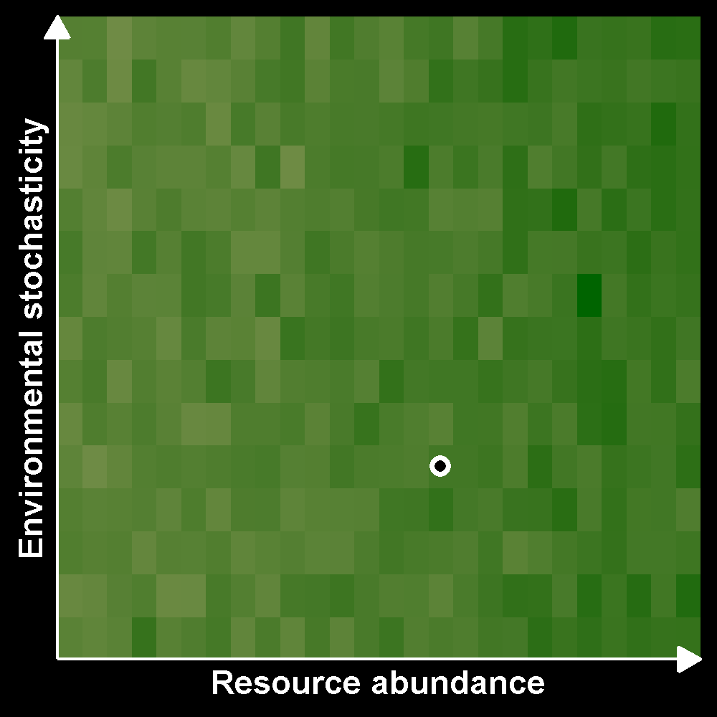
Fuzzy gralbers (Gralbus wagneri)
Very elusive, but born with GPS
Live in abstract space
Eat green pixels
Cannot sleep

Slide 6
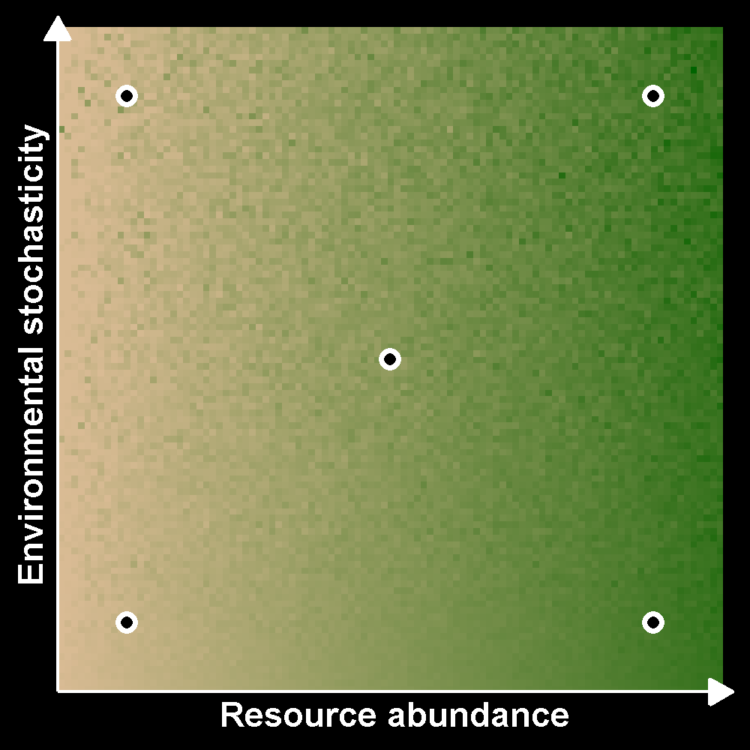
How do resource abundance and predictability affect animal movement?
Abundance decreases HR size
Stochasticity increases HR size
Interaction effects?
Effects of space restriction

Slide 7
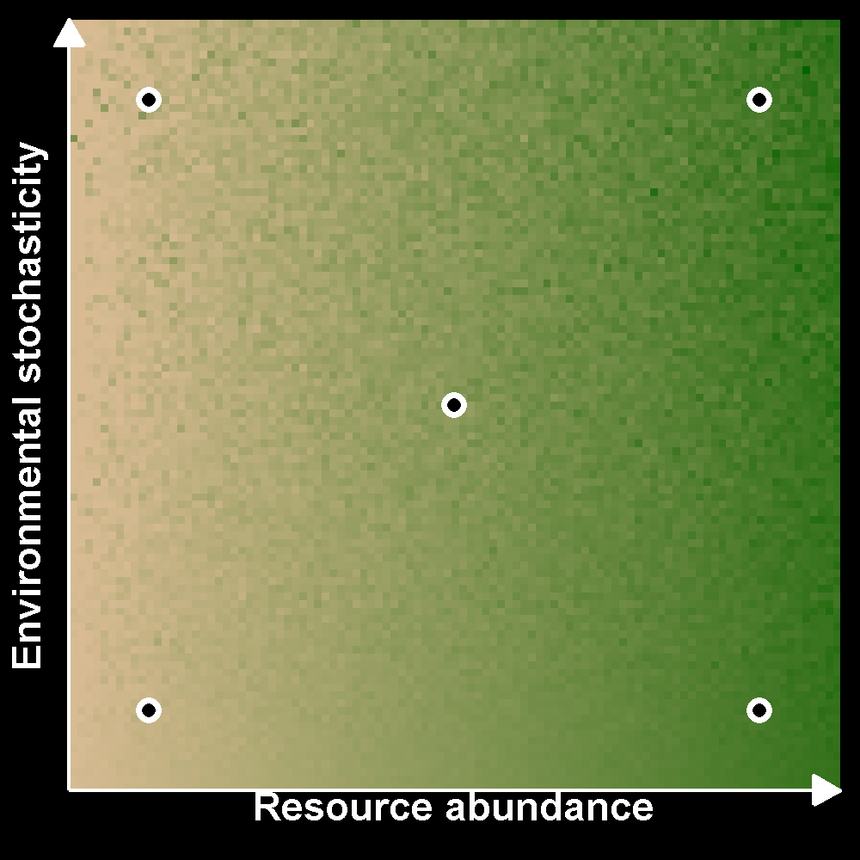
How do resource abundance and predictability affect animal movement?
Abundance decreases HR size
Stochasticity increases HR size
Interaction effects?
Effects of space restriction

Slide 8
Modeling movement data

Slide 9
Common issues with movement data
Irregular sampling in time
Spatiotemporal autocorrelation
Most common methods don’t address these issues
GPS measurement error

Slide 10
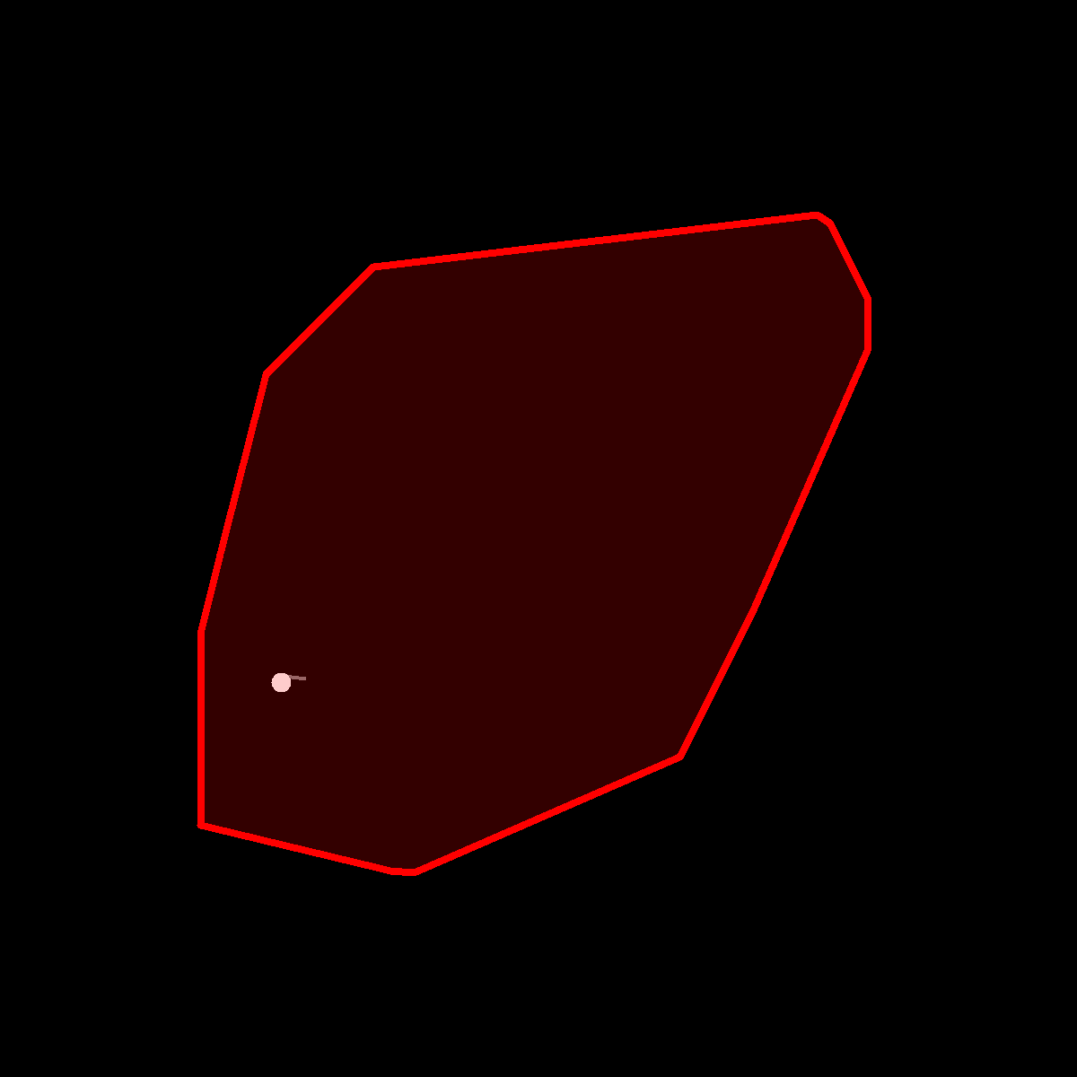
Minimum Convex Polygons (MCPs)
Very common method
Convex polygon with X% of data
Inflexible (convex)
Ignores autocorrelation

Slide 11
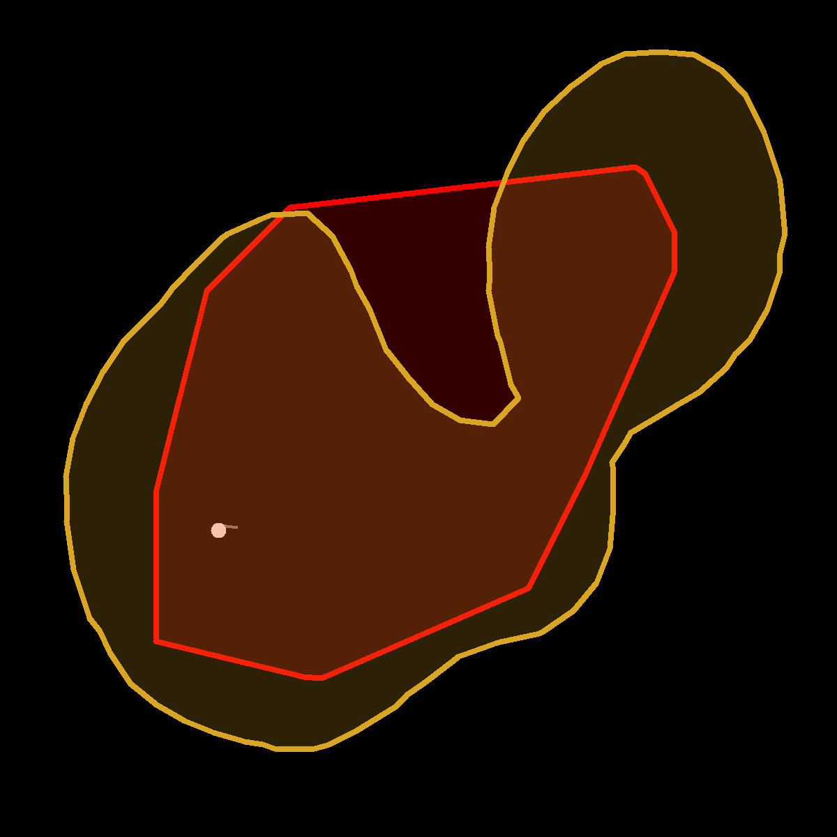
Kernel Density Estimation (KDE)
Common method
Kernel covering X% of the data
Flexible
Ignores autocorrelation

Slide 12
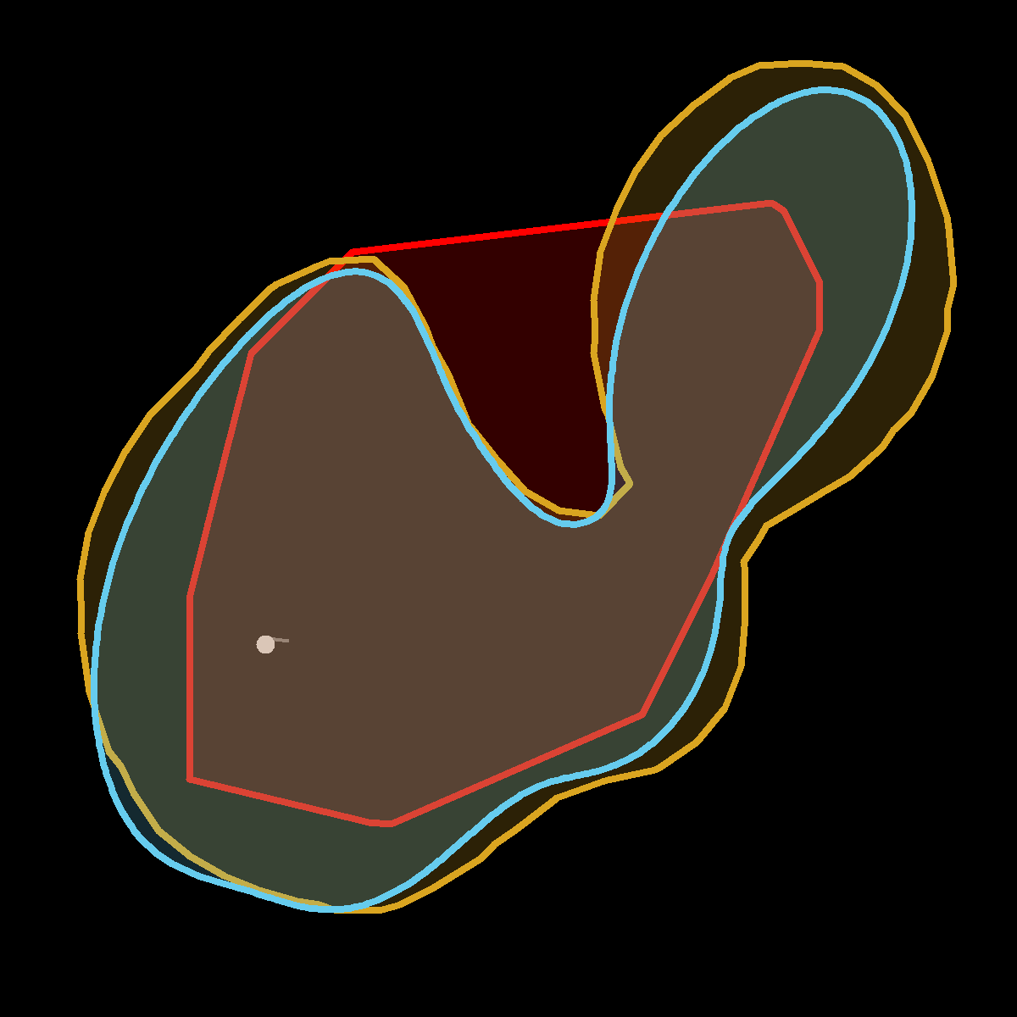
Autocorrelated Kernel Density Estimation (AKDE)
Recent method
Kernel covering X% of the data
Flexible
Accounts for autocorrelation

Slide 13
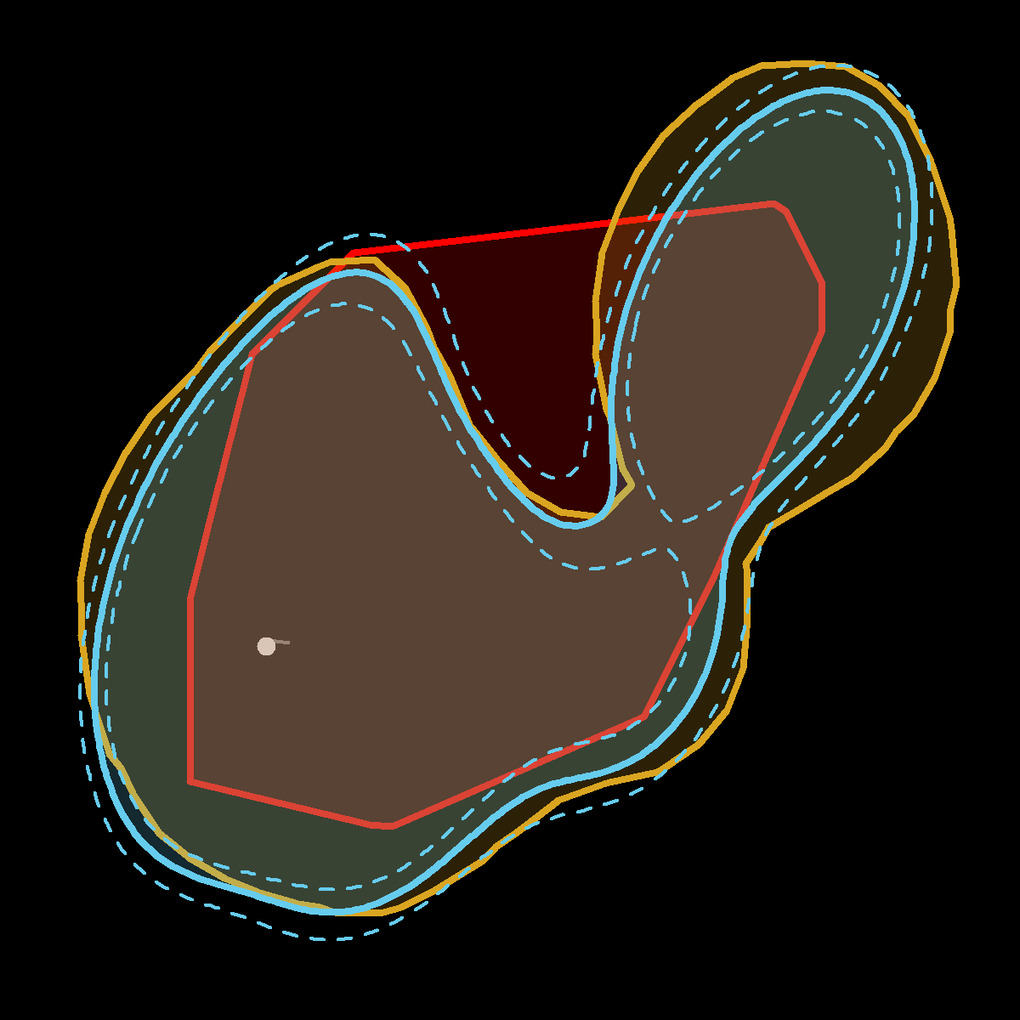
Autocorrelated Kernel Density Estimation (AKDE)
Recent method
Kernel covering X% of the data
Flexible
Accounts for autocorrelation

Slide 14
Integrating stochasticity

Slide 15
Environmental stochasticity
Normalized Difference Vegetation Index
Range in yearly temperature, precipitation
Summarize to first 2 PCA axes?

Slide 16
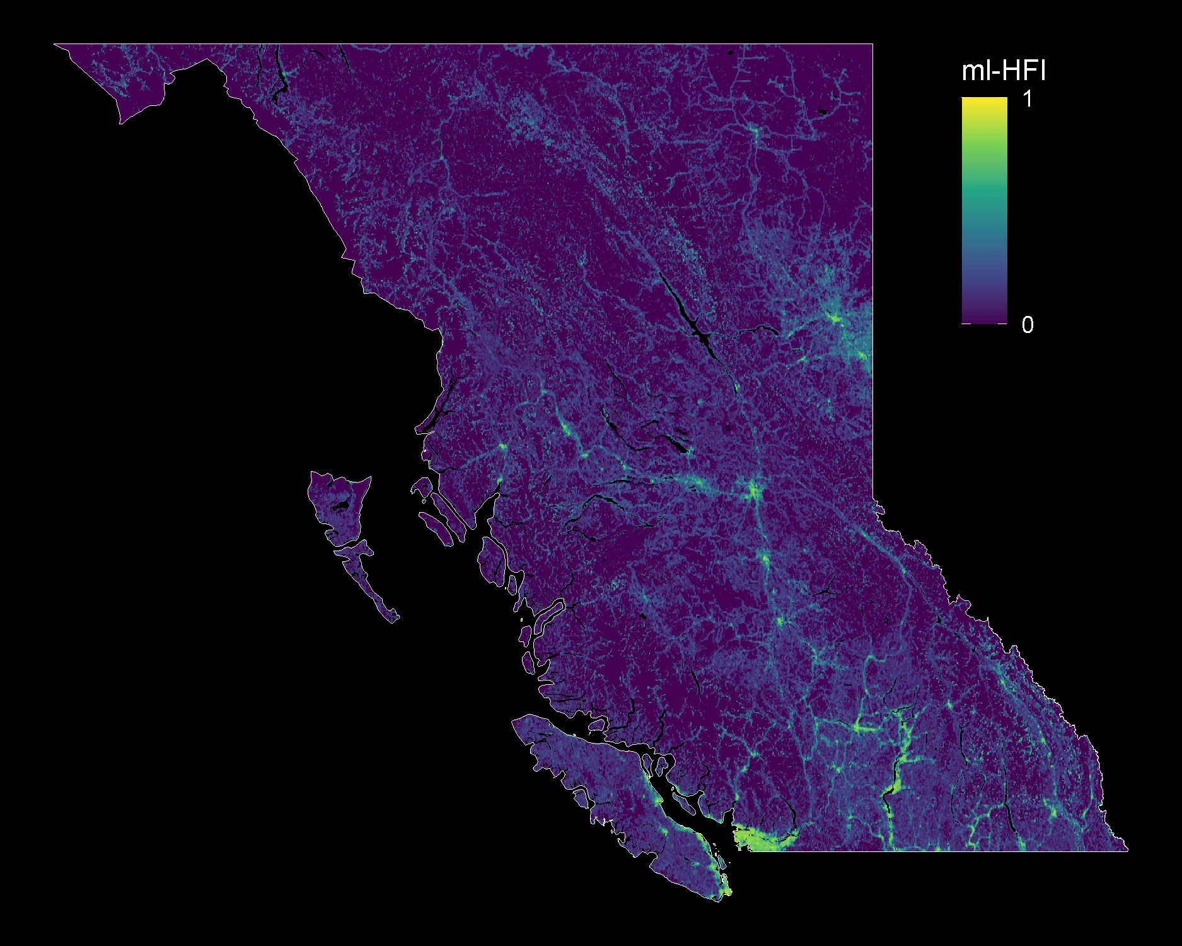
Machine-learning Human Footprint Index
Unitless index
0 = no modification
1 = maximum modification
Static in time (data: 2000-2019)
ml-HFI raster: Keys, Barnes, & Carter 2021. doi.org/10.1088/1748-9326/ABE00A
BC multipolygon: Statistics Canada

Slide 17
Modeling it all

Slide 18
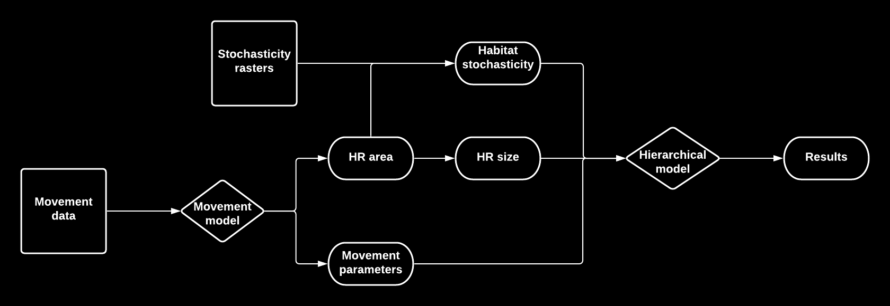
Lots of modeling for lots of data
Notes:
>1500 animals, 77 globally-distributed species

Slide 19
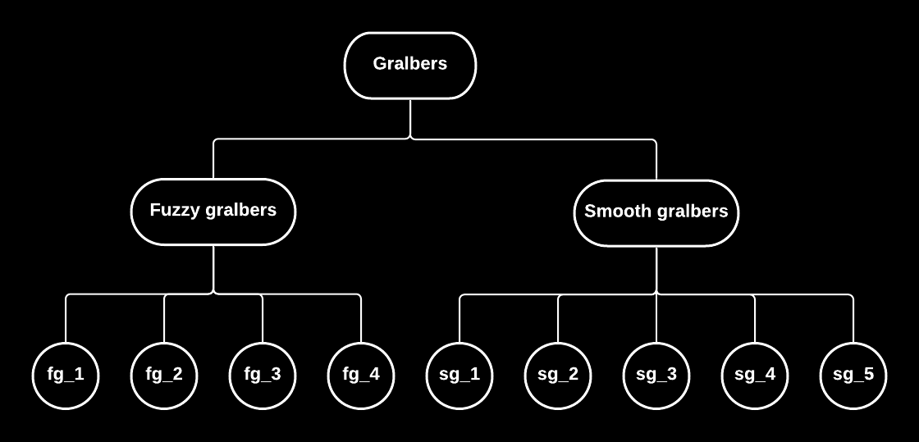
Estimating common trends
Effects of abundance and stochasticity on:
Home range size
Average speed
Autocorrelation parameters:
range crossing time
directional persistence

Slide 20
How do resource abundance and predictability affect animal movement?

Slide 21



Funder acknowledgement

Slide 22
Stefano Mezzini – M.Sc. Biol. – stefano.mezzini@ubc.ca

Slide 23
Additional slides

Slide 24
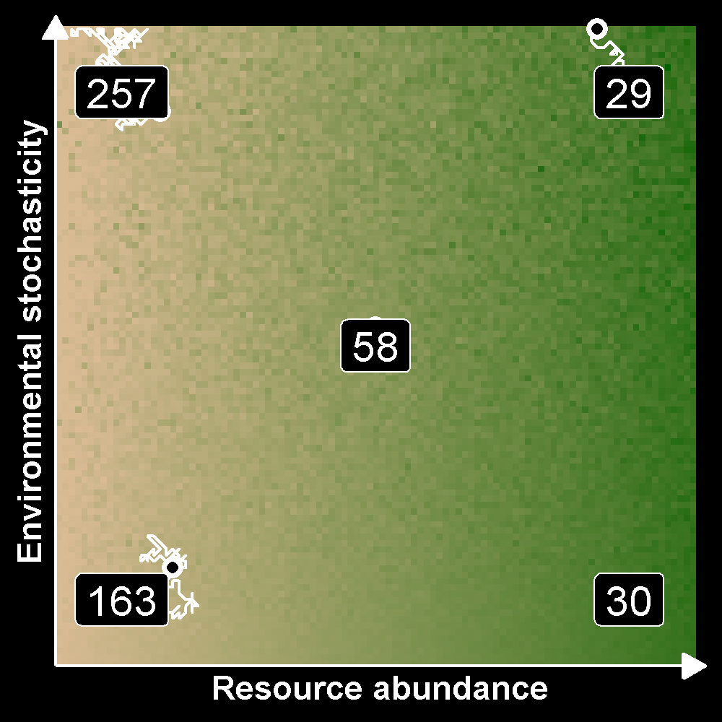
How do resource abundance and predictability affect animal movement?
Abundance decreases HR size
Stochasticity increases HR size
Interaction effects?
Effects of space restriction

